Slide 1
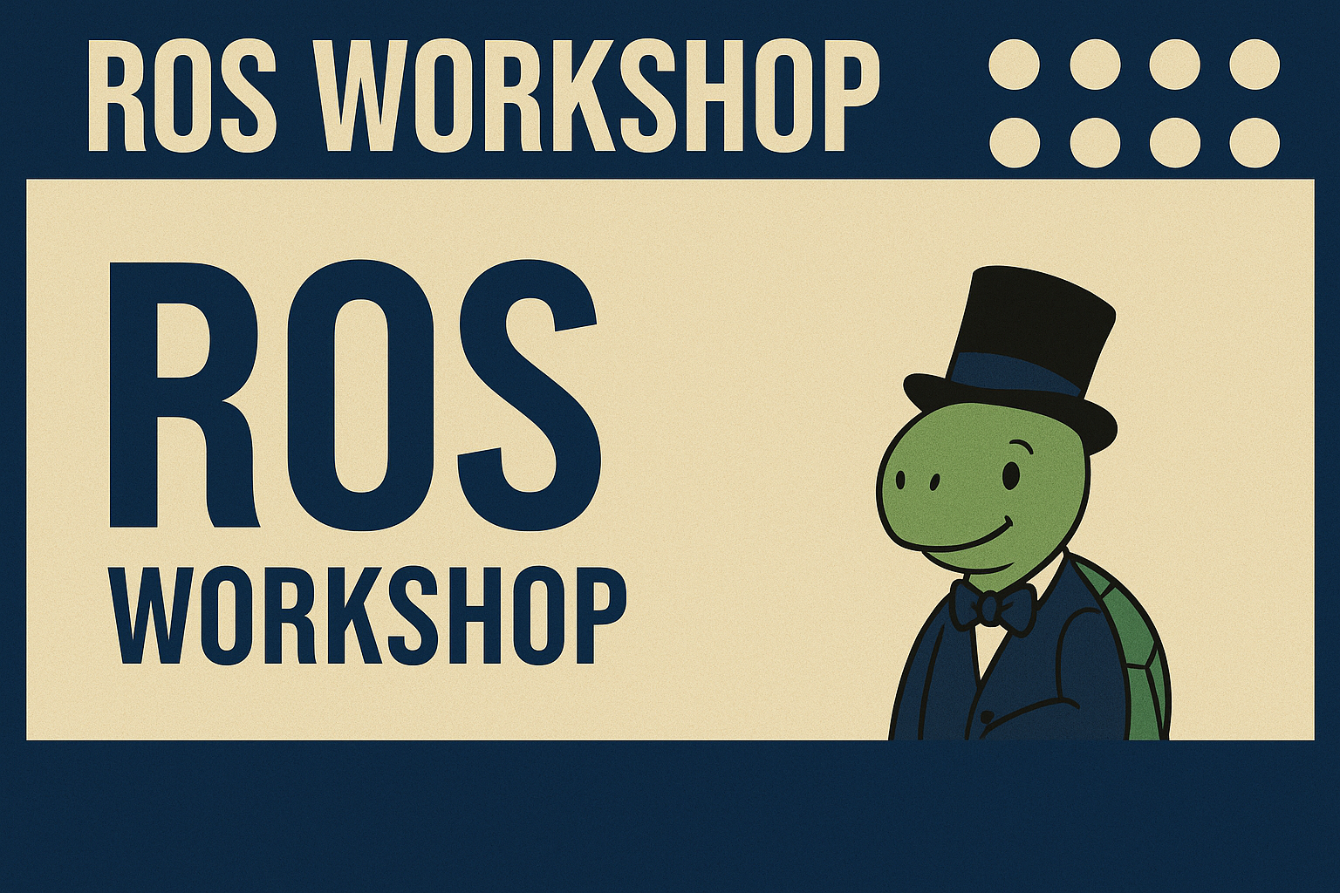

06/05/25 - B15 LM4

Slide 2
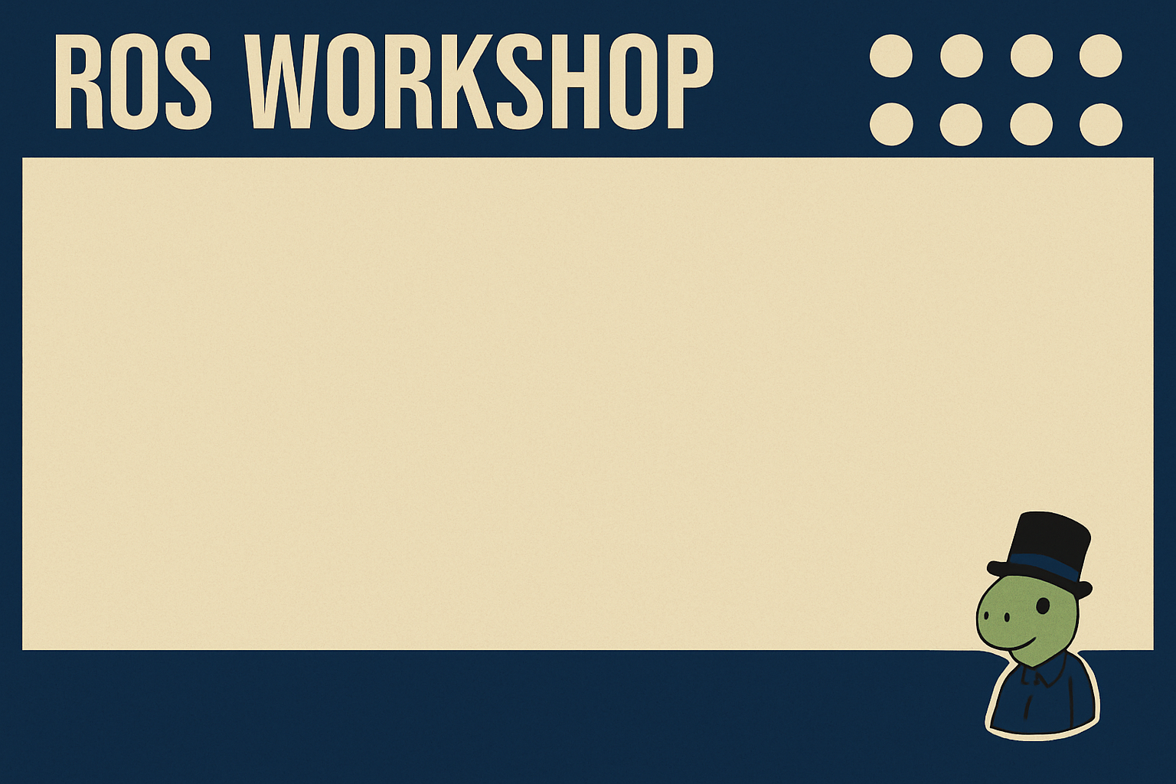
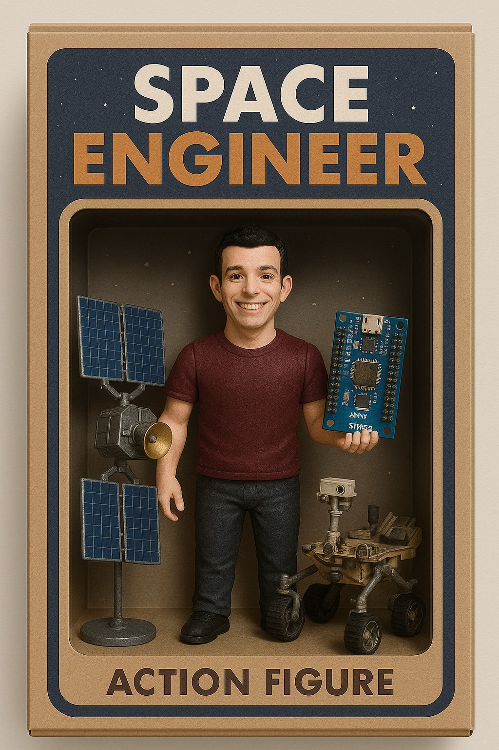
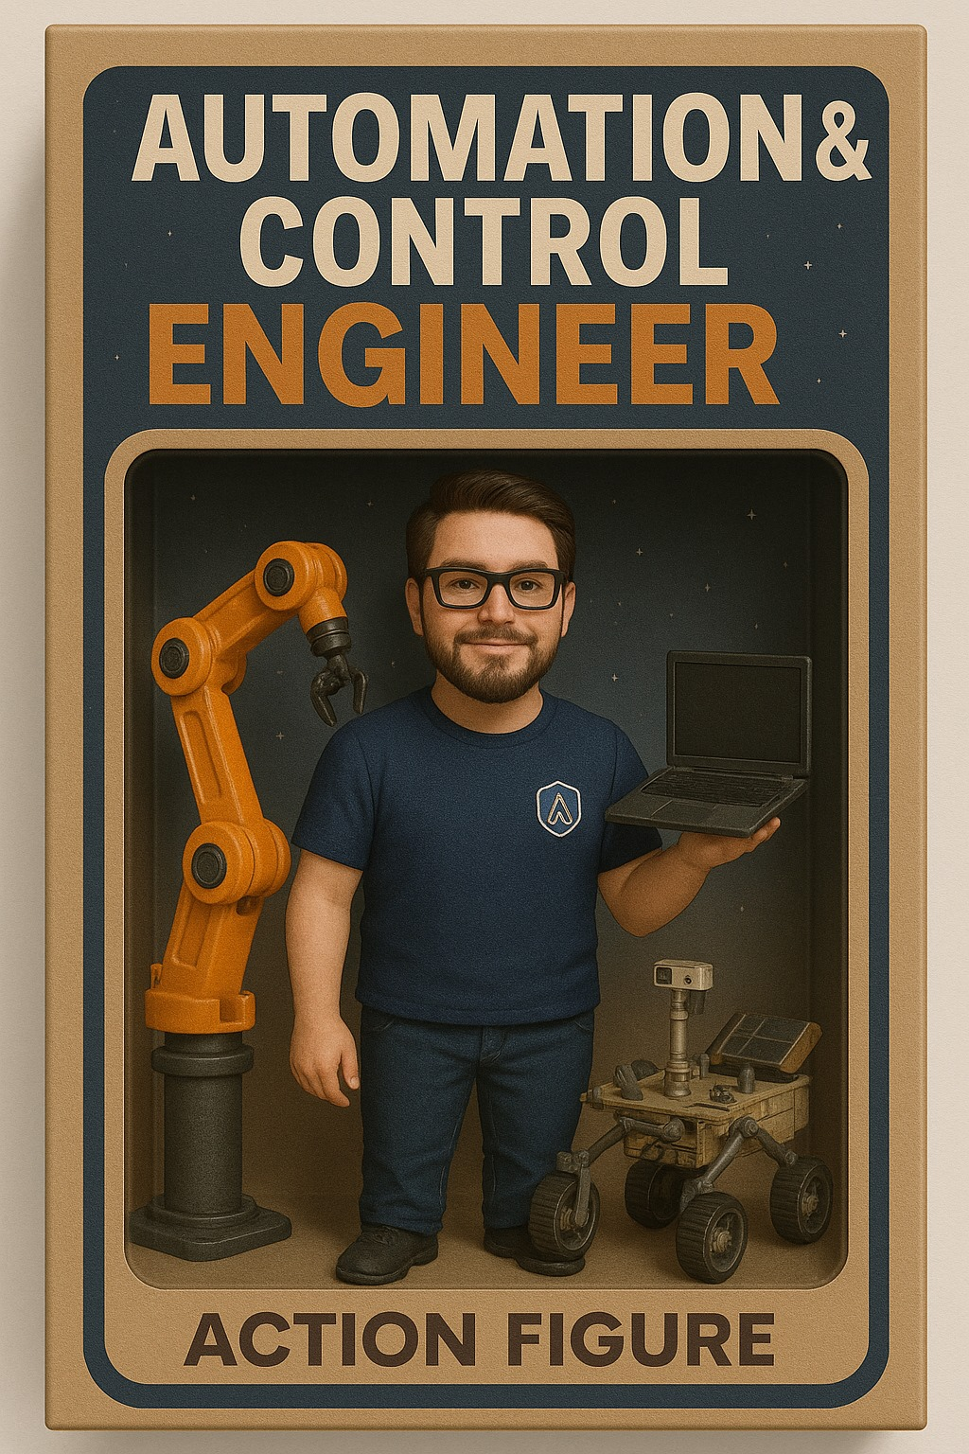
HELLO!
Federico De Donatis
Luca Attorrese

Slide 3


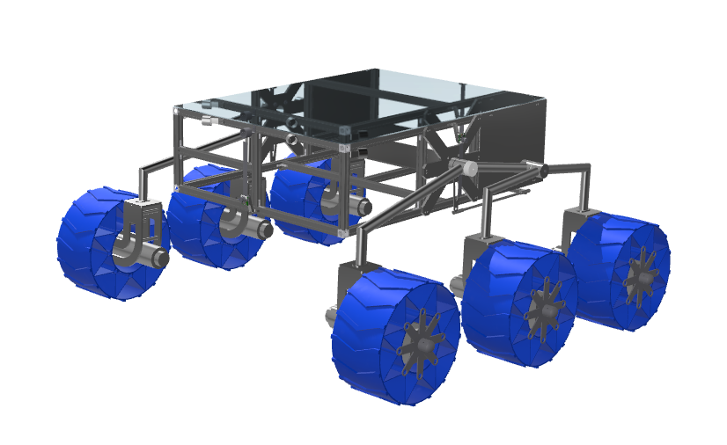

[R]overTech
Student association
Build an autonomous rover
With an autonomous arm
With an autonomous drone
For the European Rover Challenge (ERC)
Krakow

Slide 4
Scheduling
6th May - B15 LM4 - Introduction to the software ROS and first examples
12th May - B15 LM4 - Introduction to the GNSS module and how to use GNSS data inside ROS
16th May - B15 LM4 - Introduction to the navigation
problem and examples - B15 LM4

Slide 5
What is ROS?
The Robot Operating System (ROS) is a set of software libraries and tools that help you build robot applications. From drivers to state-of-the-art algorithms, and with powerful developer tools, ROS has what you need for your next robotics project.
And it's all open source.

Slide 6
What is ROS? - MW
ROS is a MIDDLEWARE:
Middleware is software that acts like a bridge between different parts of a system — especially between the low-level hardware and the high-level applications.

Slide 7
What is ROS?-Example
Example of Middleware (ROS) in a Robot:
Camera captures images.
Obstacle Detector Node processes images.
Motor Controller Node moves or stops wheels.
Middleware (ROS) lets these nodes communicate without being directly connected — like a message bus between them.

Slide 8
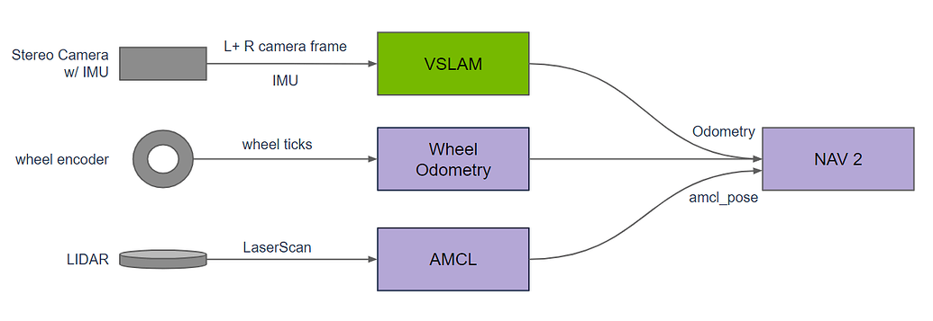
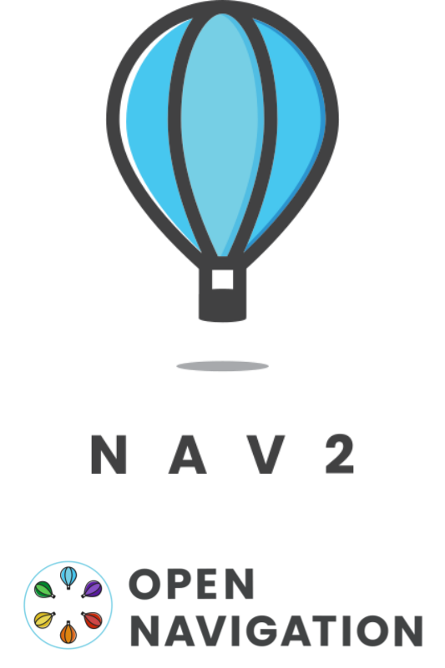
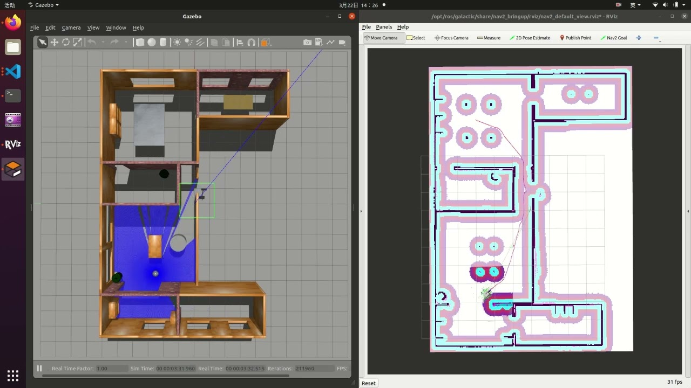
What is ROS?-NAV2

Slide 9
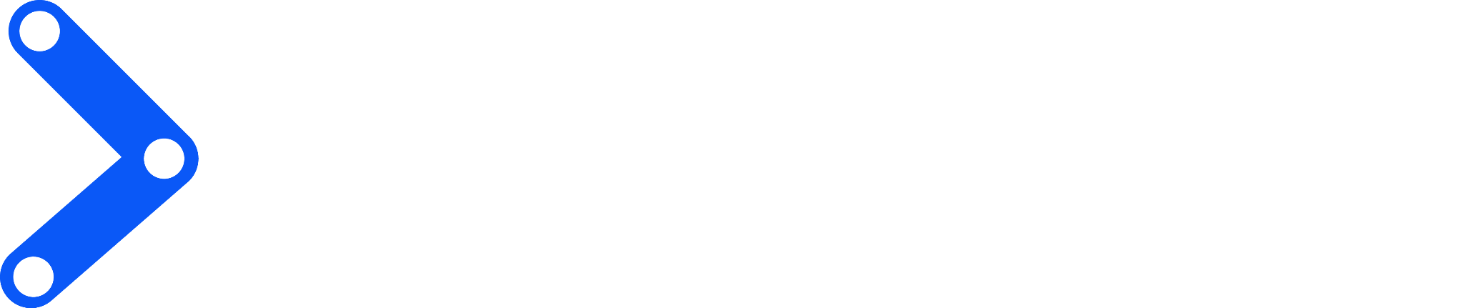
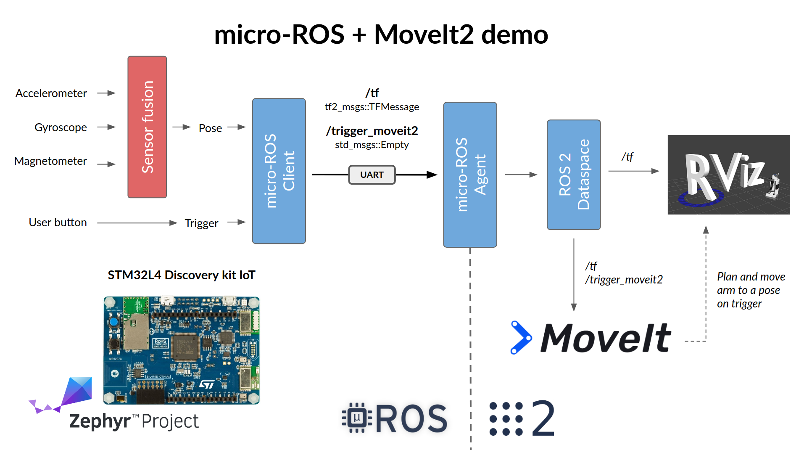
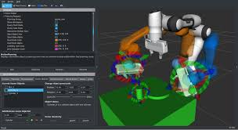
What is ROS?-MoveIt

Slide 10
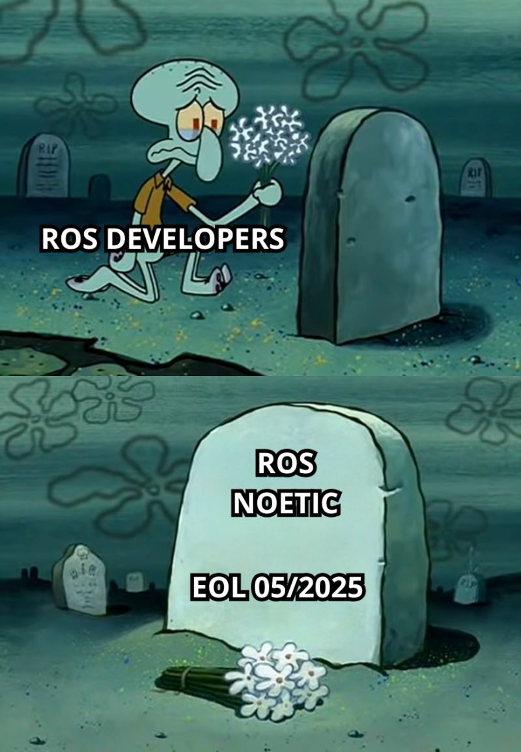
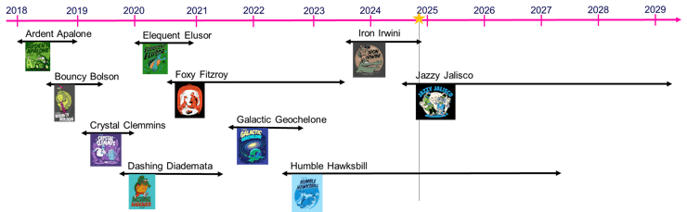

ROS(1) vs ROS2

Slide 11
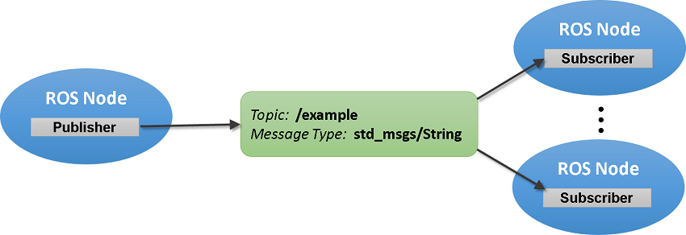
ROS: Nomenclature
- Node: a program (read a sensor, sensor fusion, control law…).
- Topic: bridge where different nodes can share data (continuously).
- Service: (one time) synchronous communication mechanism (ask for data or send interrupt).
- Action: is like a service, but for longer tasks that take time and can give feedback while running (follow a path with encoder feedback).

Slide 12

Installation (Windows)
Windows Subsystem for Linux: allows to simulate a Linux environment, with command-line tools and GUI
Uses Ubuntu 24.04 (Noble)
The compatible ros2 distribution is Jazzy Jalisco

Slide 13
Installation (Windows)
Open Windows Powershell
wsl --install
First time may require username and password (p.s. Password don’t appears while typing!)
If wsl is already installed it will open

Slide 14



Installation
https://docs.ros.org/en/jazzy/Installation/Ubuntu-Install-Debs.html
https://docs.ros.org/en/jazzy/Installation/Alternatives/macOS-Development-Setup.html

Slide 15
Ex1.1: Turtlebot
[Win/Ub: tmux]
[Win/Ub: source /opt/ros/jazzy/setup.bash]
[MacOs: . ~/ros2_jazzy/install/setup.zsh]
ros2 run turtlesim turtlesim_node
In a new terminal (Win/Ub: Ctrl+b then %):
ros2 run turtlesim turtle_teleop_key

Slide 16
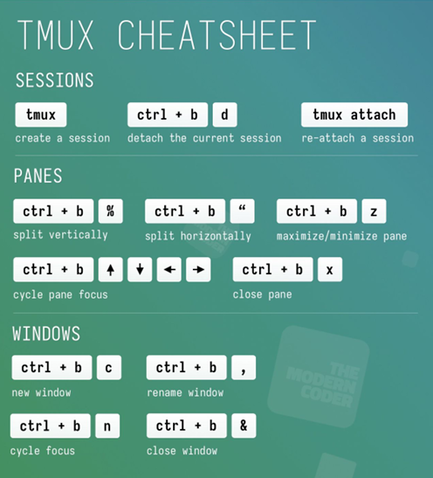
Ex1.1: Turtlebot

Slide 17
Ex1.2: Simple Node
Let’s create a new package:
ros2 pkg create --build-type ament_cmake package_prova
ls package_prova/

Slide 18
Ex1.2: Simple Node
Let’s add publisher and subscriber in the src folder:
vi Test_pub.cpp
Go to: https://github.com/LucaAttorrese/ROS-Workshop/
Copy file from GitHub, esc and write :wq
vi Test_sub.cpp
Copy file, esc and write :wq

Slide 19
Ex1.2: Simple Node
Let’s modify package.xml:
vi package.xml
Type “i” to go in INSERT mode
<buildtool_depend>ament_cmake</buildtool_depend>
<depend>rclcpp</depend>
<depend>std_msgs</depend>
esc and write :wq

Slide 20
Ex1.2: Simple Node
Let’s modify CMakeList.txt:
find_package(<dependency name> REQUIRED) // ament_cmake, rclcpp, std_msgs
add_executable(<file_name> src/<file_name>.cpp) // Test_sub, Test_pub
ament_target_dependencies(<file_name> <dependency name> <dependency name> …)
install(TARGETS
<file_name>
DESTINATION lib/${PROJECT_NAME})

Slide 21
Ex1.2: Simple Node
Let’s build the package (out of package_prova folder in tmux!):
colcon build --packages-select package_prova
source ./install/setup.bash
ros2 run package_prova Test_sub
New terminal (Win/Ub: Ctrl+b then %)
source ./install/setup.bash
ros2 run package_prova Test_pub

Slide 22
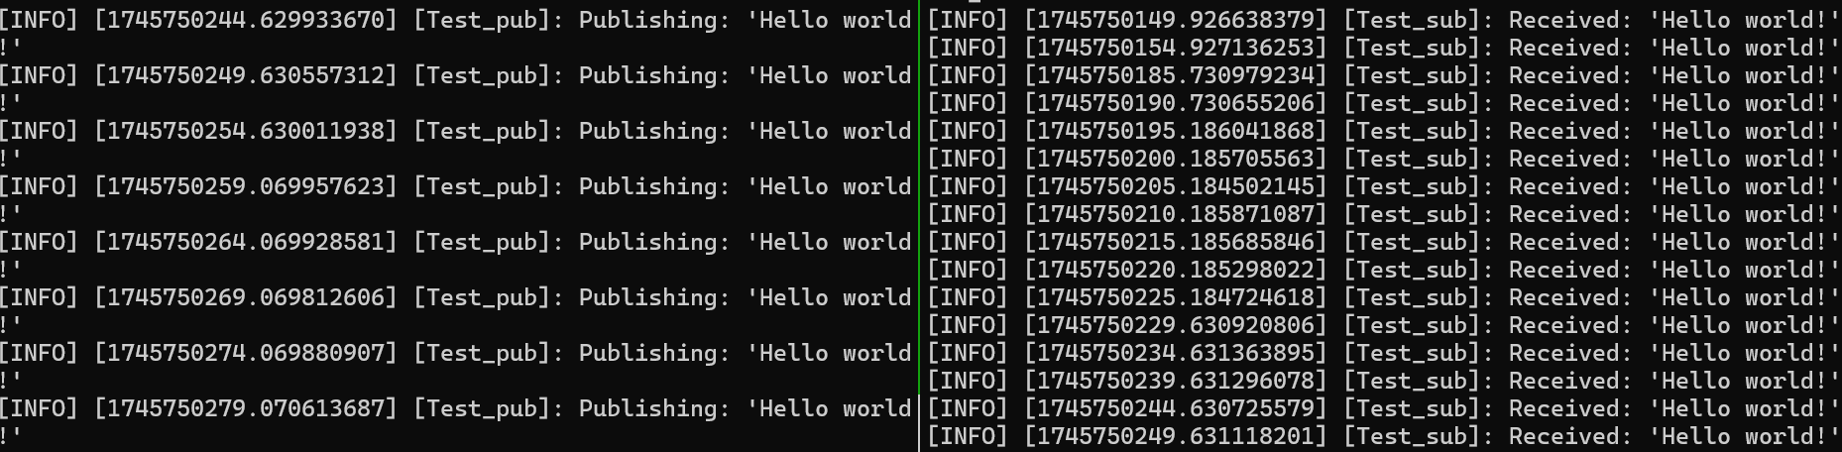
Ex1.2: Simple Node

Slide 23
Ex1.3: Launch file
Create a launch folder in ./package_prova
cd package_prova && mkdir launch && cd launch
Create and copy the launch file
vi test_launch.launch.py
Modify the CMakeList.txt
install(DIRECTORY launch DESTINATION share/${PROJECT_NAME}/)

Slide 24
Ex1.3: Launch file
Let’s build the package (out of package_prova folder in tmux!):
colcon build --packages-select package_prova
source ./install/setup.bash
ros2 launch package_prova test_launch.launch.py

Slide 25
Thank you!
We hope to see you on 12th May in B15 LM4 to complete the previous session’s exercises and discover the world of localization.

